Slide 1
More Trees
COL 106
Amit Kumar and Shweta Agrawal
Most slides courtesy : Douglas Wilhelm Harder, MMath, UWaterloo
dwharder@alumni.uwaterloo.ca

Slide 2
Last time..
We saw Preorder, Inorder, Postorder traversals
Recall that in Preorder traversal, a node is visited before all its descendents
Saw recursive implementation
Saw stack implementation
Can we do better?

Slide 3
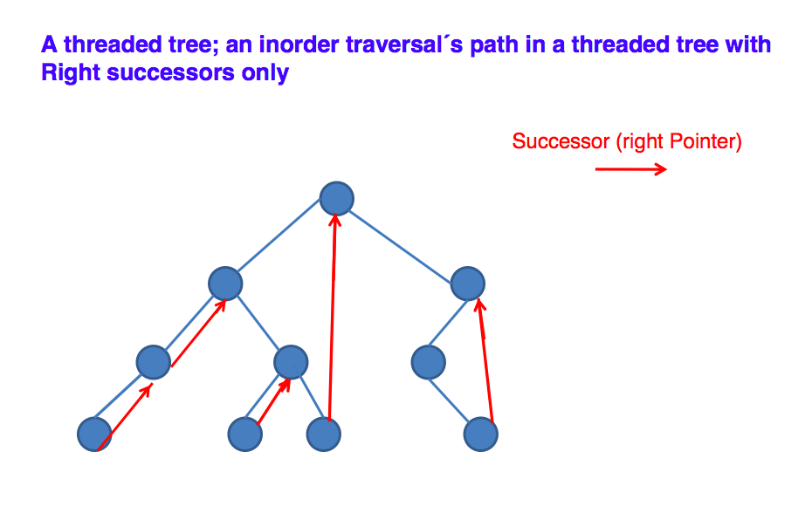
Morris Traversal No stacks, no recursion!

Slide 4
Inorder Traversal
P
M
L
S
E
R
A
A
T
E
E
inorder predecessor of node with left subtree
is the right child of node’s left subtree

Slide 5
Morris Traversal
The NULL right child of a node is used to point to the node’s inorder successor. This is called the start of a thread.
If a node has a left sub-tree then it is the end-point of a thread.
The start-point of its thread is its inorder predecessor, i.e. the right-most child of its left subtree
Thread goes from node to inorder successor

Slide 6
Morris Traversal
1. Initialize current as root
2. While current is not NULL
If current does not have left child
a) Print current’s data
b) Go to the right, i.e., current = current->right
Else
a) Make current as right child of the rightmost node in current's left subtree
b) Go to this left child, i.e., current = current->left

Slide 7
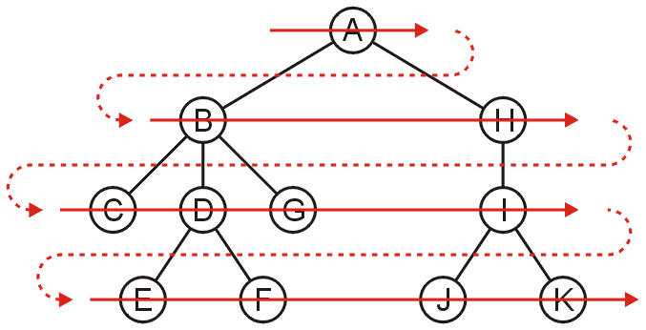
Breadth first traversal
The breadth-first traversal visits all nodes at depth k before proceeding onto depth k + 1
Easy to implement using a queue
Order: A B H C D G I E F J K

Slide 8
Breadth-First Traversal
Breadth-first traversals visit all nodes at a given depth
Memory may be expensive: max nodes at given depth
Create a queue and push the root node onto queue
While the queue is not empty:
Push all of its children of the front node onto the queue
Pop the front node

Slide 9
Applications
Game tree for chess would need BFS
Expression printing for language processors will need pre-order / post-order DFS depending on the processor
Deleting nodes in binary search trees needs postorder traversal (will see this later)

Slide 10
Binary Search Trees
Recall that with a binary tree, we can dictate an order on the two children
We will exploit this order:
Require all objects in the left sub-tree to be less than the object stored in the root node, and
Require all objects in the right sub-tree to be greater than the object in the root object

Slide 11
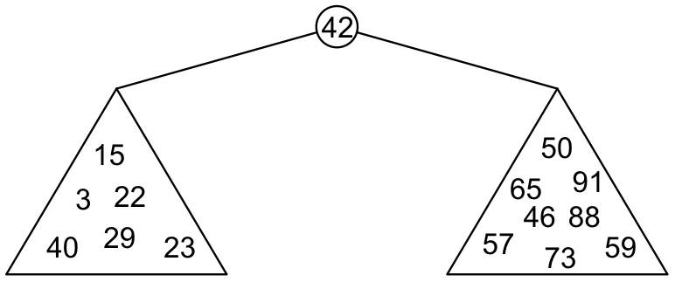
Binary Search Trees
Graphically,
Each of the two sub-trees will themselves be binary search trees

Slide 12
Binary Search Trees
Notice that we can already use this structure for searching: examine the root node and if we have not found what we are looking for:
If the object is less than what is stored in the root node, continue searching in the left sub-tree
Otherwise, continue searching the right sub-tree
With a linear order, one of the following three must be true:
a < b a = b a > b

Slide 13
Definition
Thus, we define a non-empty binary search tree as a binary tree with the following properties:
The left sub-tree (if any) is a binary search tree and all elements are less than the root element, and
The right sub-tree (if any) is a binary search tree and all elements are greater than the root element

Slide 14
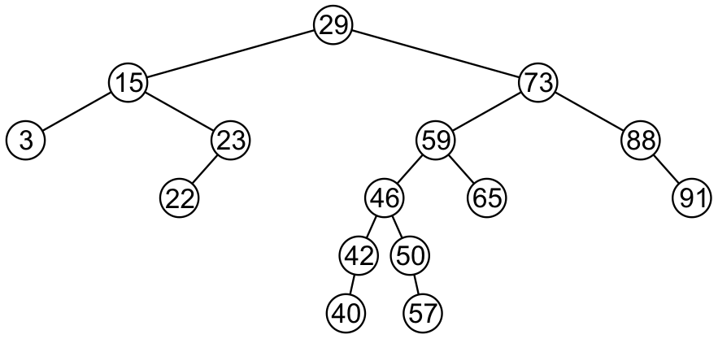
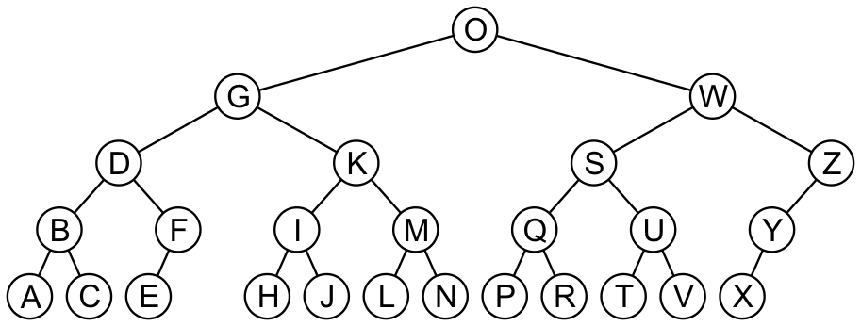
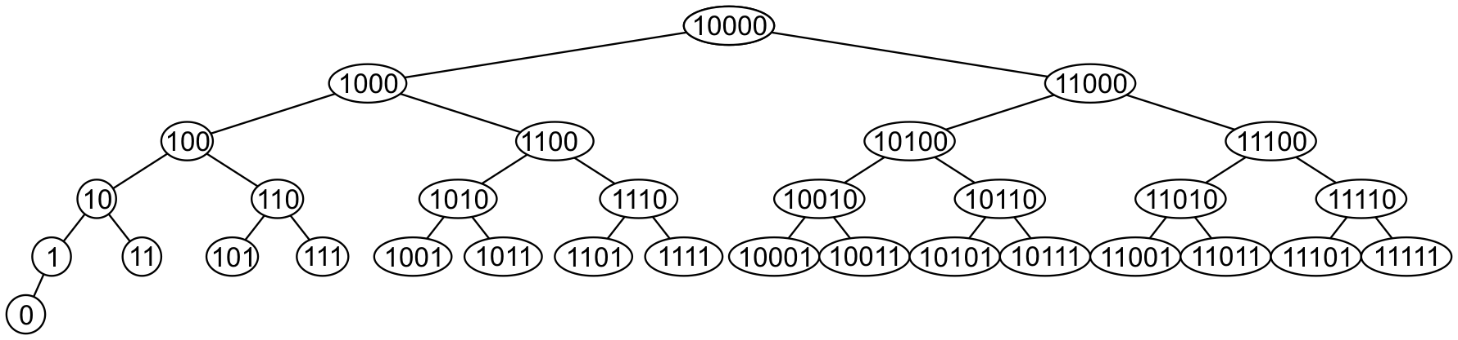
Examples
Here are other examples of binary search trees:

Slide 15
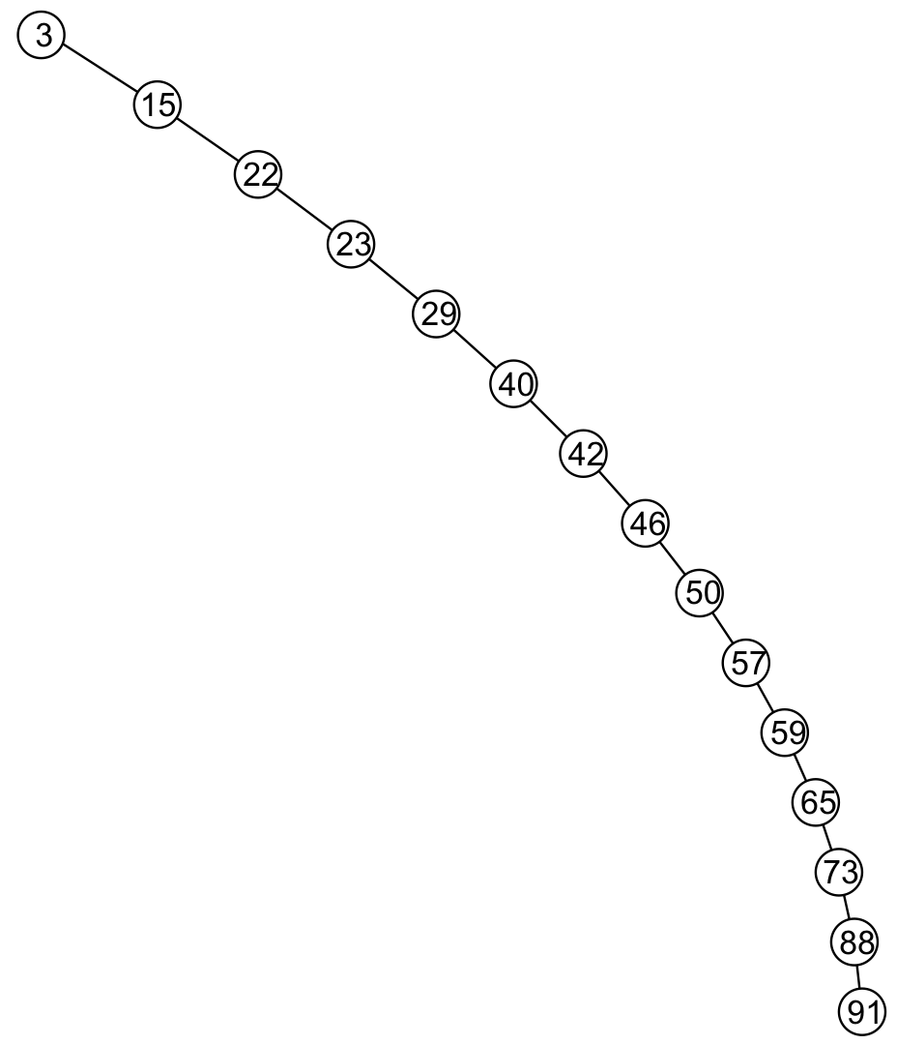
Examples
Unfortunately, it is possible to construct degenerate binary search trees
This is equivalent to a linked list, i.e., O(n)

Slide 16
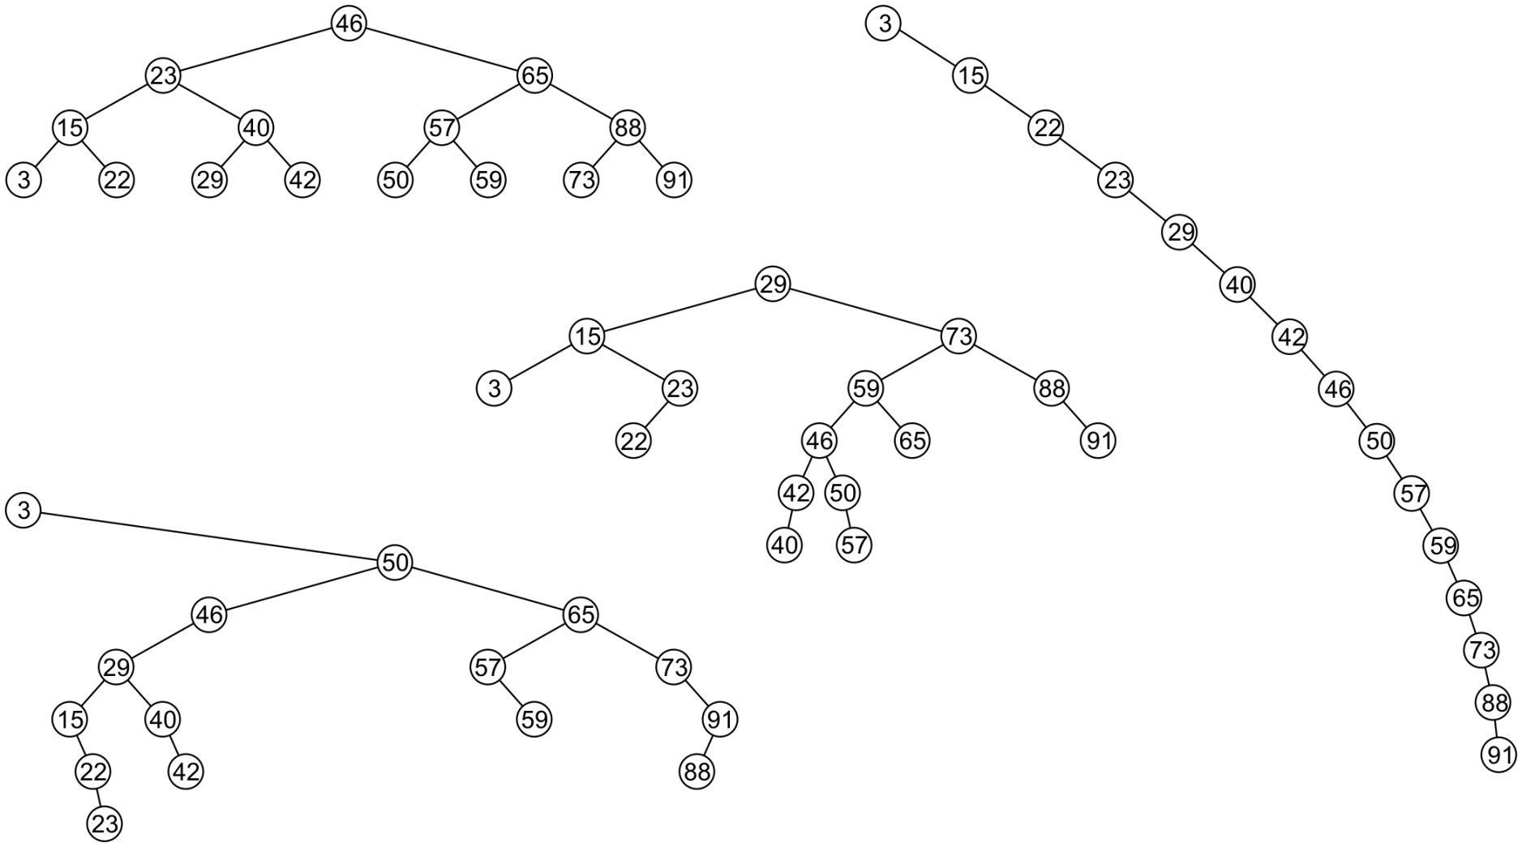
Examples
All these binary search trees store the same data

Slide 17
Duplicate Elements
We will assume that in any binary tree, we are not storing duplicate elements unless otherwise stated
In reality, it is seldom the case where duplicate elements in a container must be stored as separate entities
You can always consider duplicate elements with modifications to the algorithms we will cover

Slide 18
Implementation
Any class which uses this binary-search-tree class must therefore implement:
bool operator<=( Type const &, Type const & );
bool operator< ( Type const &, Type const & );
bool operator==( Type const &, Type const & );
That is, we are allowed to compare two instances of this class
Examples: int and double

Slide 19
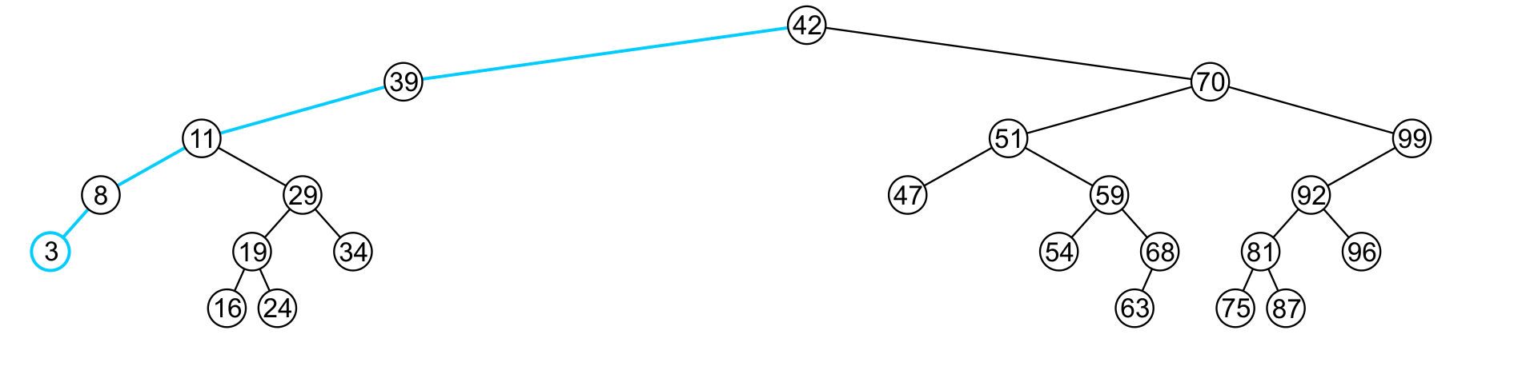
Finding the Minimum Object
The minimum object (front) may be found recursively
template <typename Type>
Type Binary_search_node<Type>::front() const {
return ( left()->empty() ) ? retrieve() : left()->front();
}
The run time O(h)

Slide 20
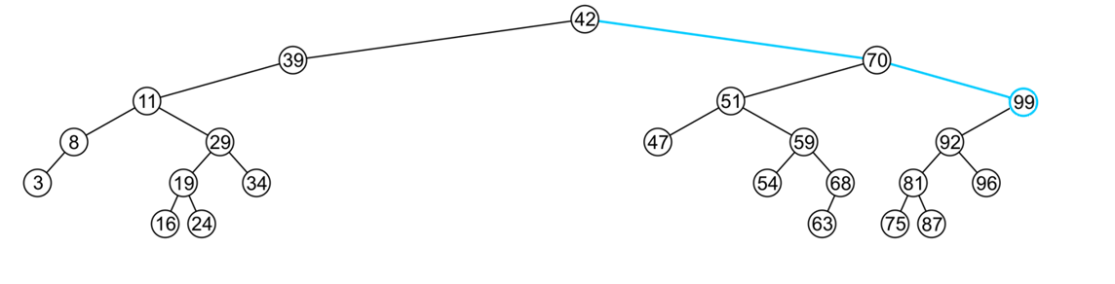
Finding the Maximum Object
As is finding the maximum object
template <typename Type>
Type Binary_search_node<Type>::back() const {
return ( right()->empty() ) ? retrieve() : right()->back();
}
The extreme values are not necessarily leaf nodes
Notes:
20

Slide 21
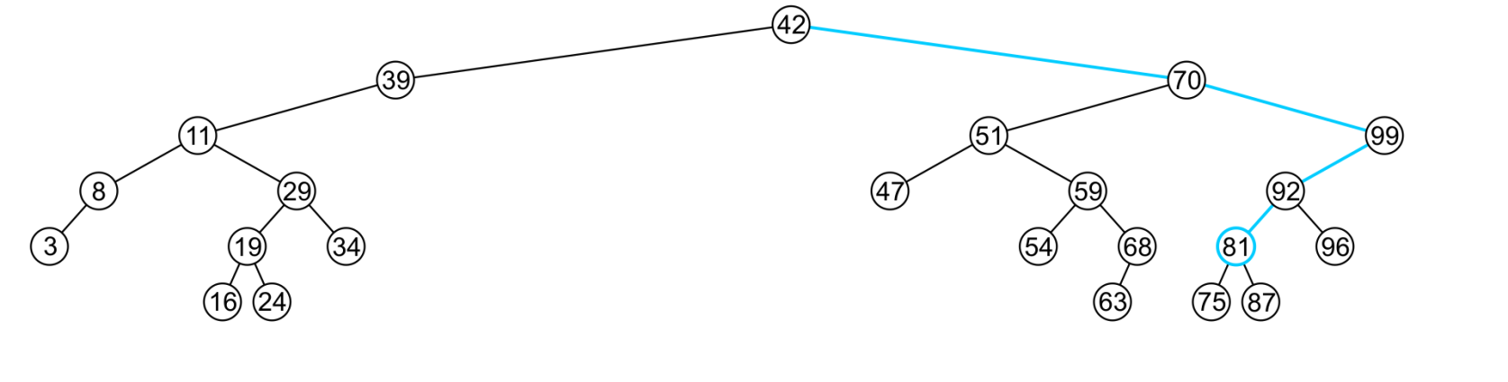
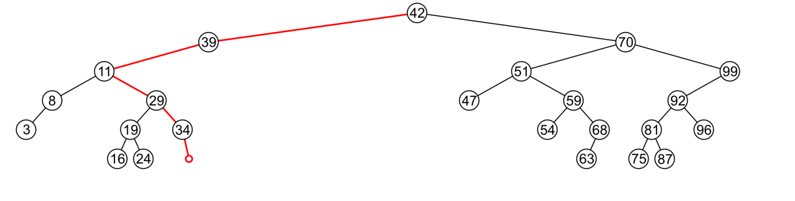
Find
To determine membership, traverse the tree based on the linear relationship:
If a node containing the value is found, e.g., 81, return 1
If an empty node is reached, e.g., 36, the object is not in the tree:

Slide 22
Insert
Recall that a Sorted List is implicitly ordered
It does not make sense to have member functions such as push_front and push_back
Insertion will be performed by a single insert member function which places the object into the correct location

Slide 23
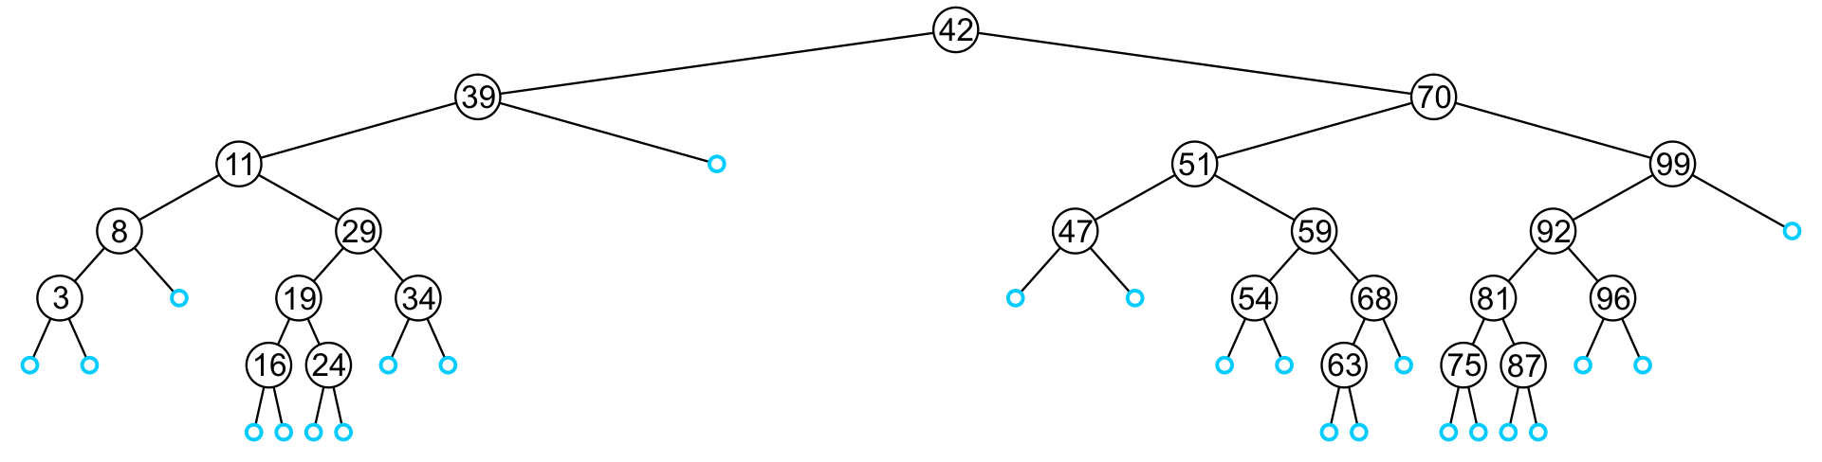
Insert
An insertion will be performed at a leaf node:
Any empty node is a possible location for an insertion
The values which may be inserted at any empty node depend on the surrounding nodes

Slide 24
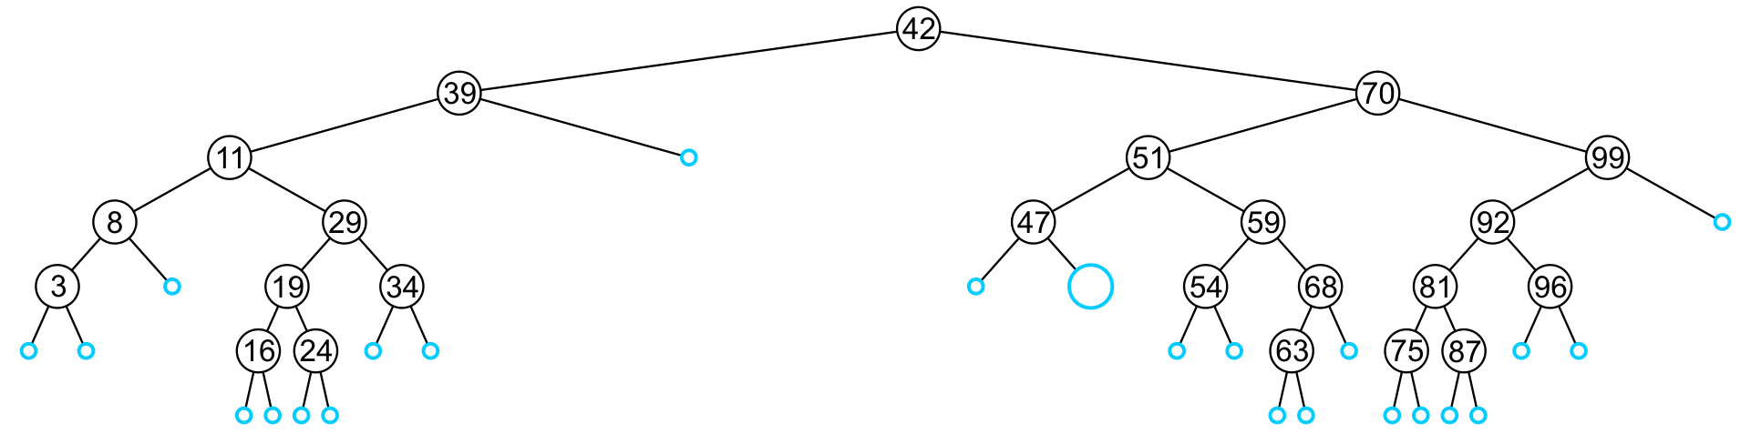
Insert
For example, this node may hold 48, 49, or 50

Slide 25
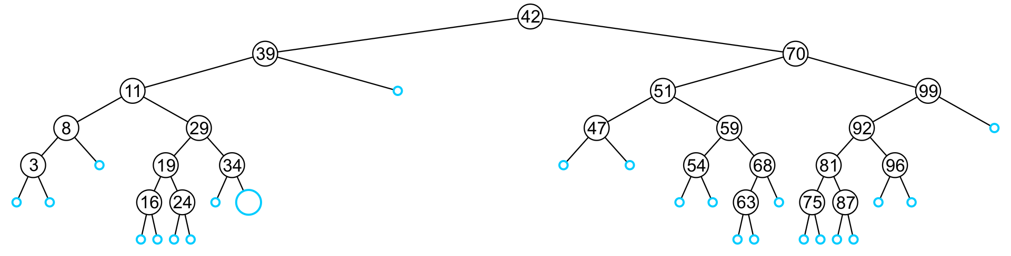
Insert
An insertion at this location must be 35, 36, 37, or 38

Slide 26
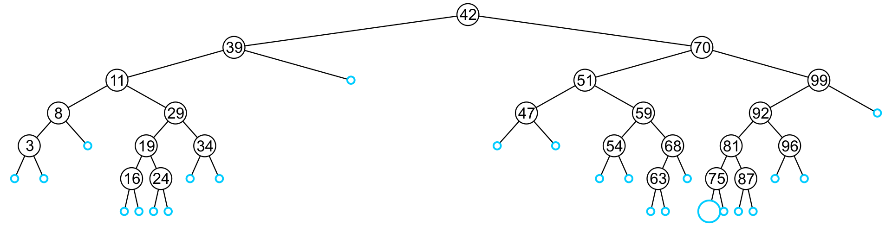
Insert
This empty node may hold values from 71 to 74

Slide 27
Insert
Like find, we will step through the tree
If we find the object already in the tree, we will return
The object is already in the binary search tree (no duplicates)
Otherwise, we will arrive at an empty node
The object will be inserted into that location
The run time is O(h)

Slide 28
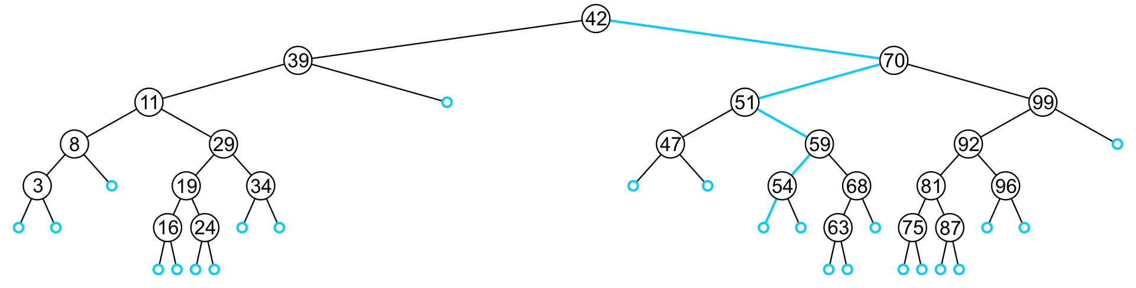
Insert
In inserting the value 52, we traverse the tree until we reach an empty node
The left sub-tree of 54 is an empty node

Slide 29
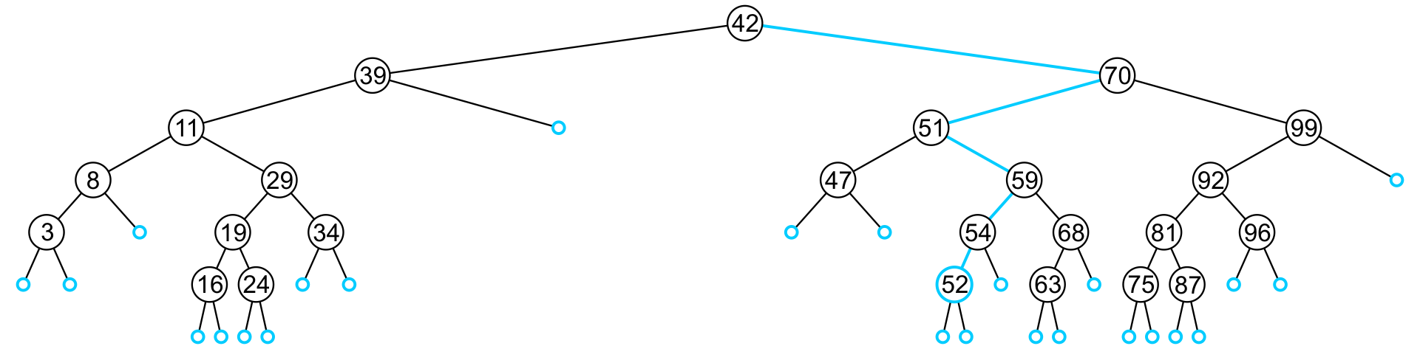
Insert
A new leaf node is created and assigned to the member variable left_tree

Slide 30
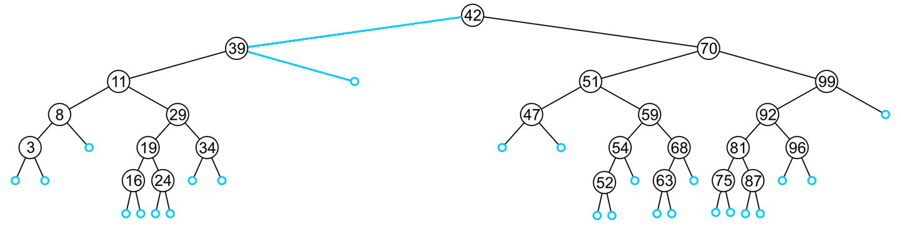
Insert
In inserting 40, we determine the right sub-tree of 39 is an empty node

Slide 31
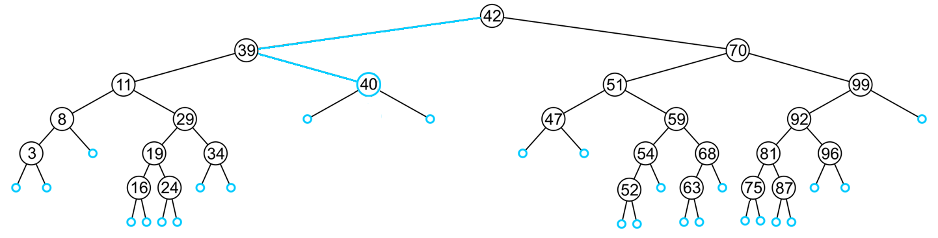
Insert
A new leaf node storing 40 is created and assigned to the member variable right_tree

Slide 32
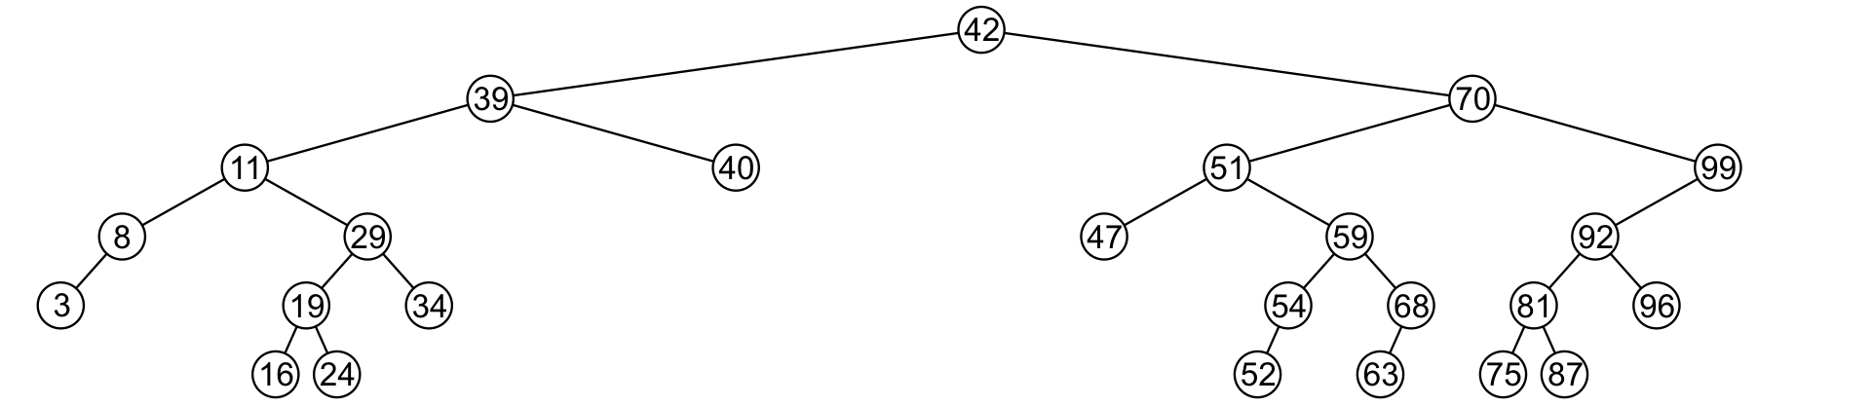
Erase
A node being erased is not always going to be a leaf node
There are three possible scenarios:
The node is a leaf node,
It has exactly one child, or
It has two children (it is a full node)

Slide 33
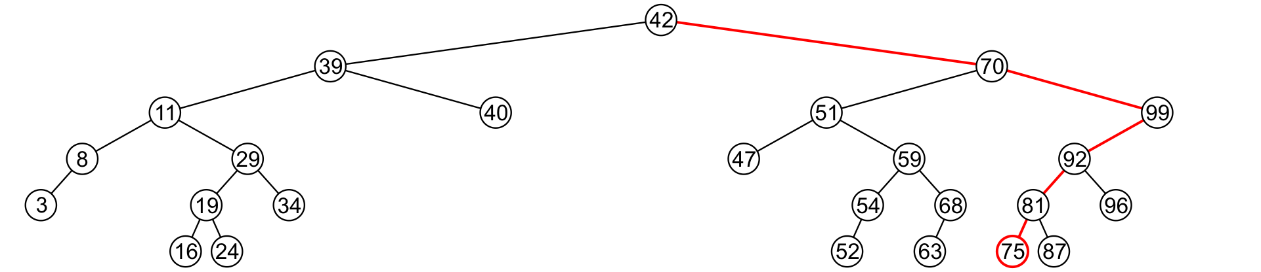
Erase
A leaf node simply must be removed and the appropriate member variable of the parent is set to nullptr
Consider removing 75

Slide 34
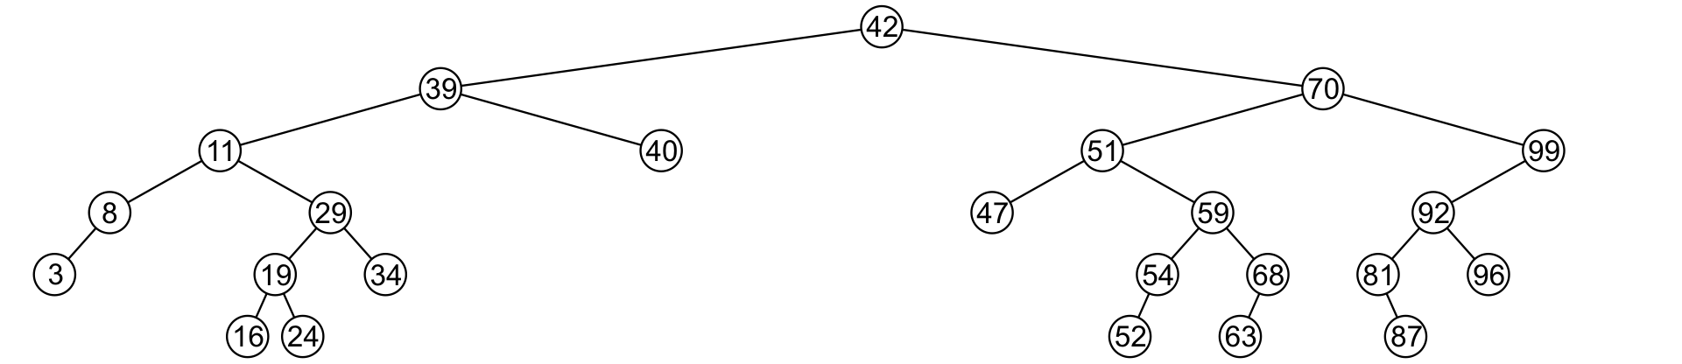
Erase
The node is deleted and left_tree of 81 is set to nullptr

Slide 35
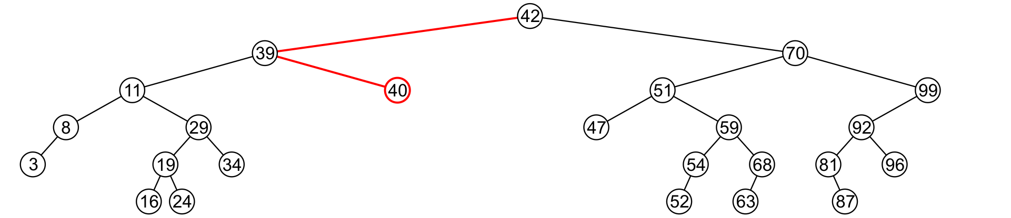
Erase
Erasing the node containing 40 is similar

Slide 36
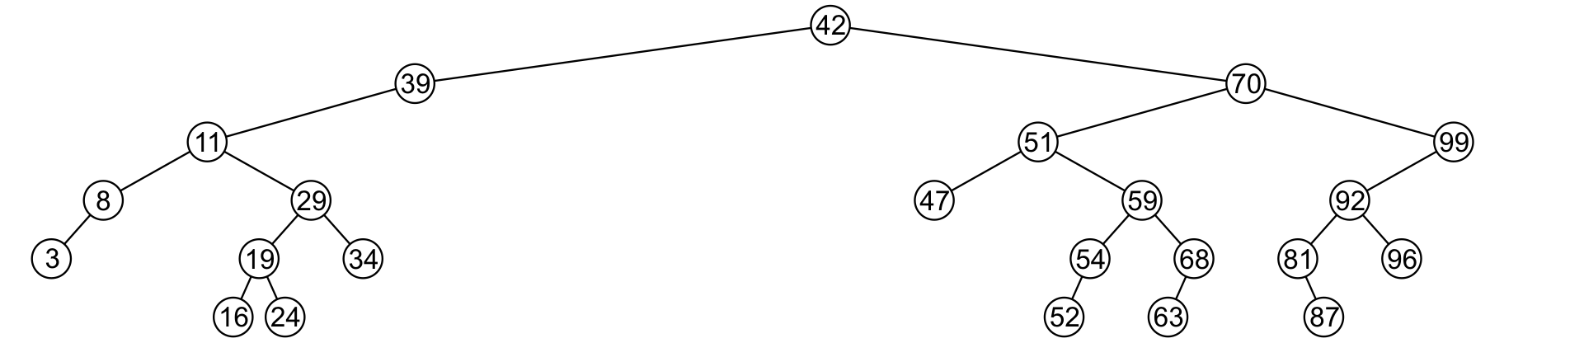
Erase
The node is deleted and right_tree of 39 is set to nullptr

Slide 37
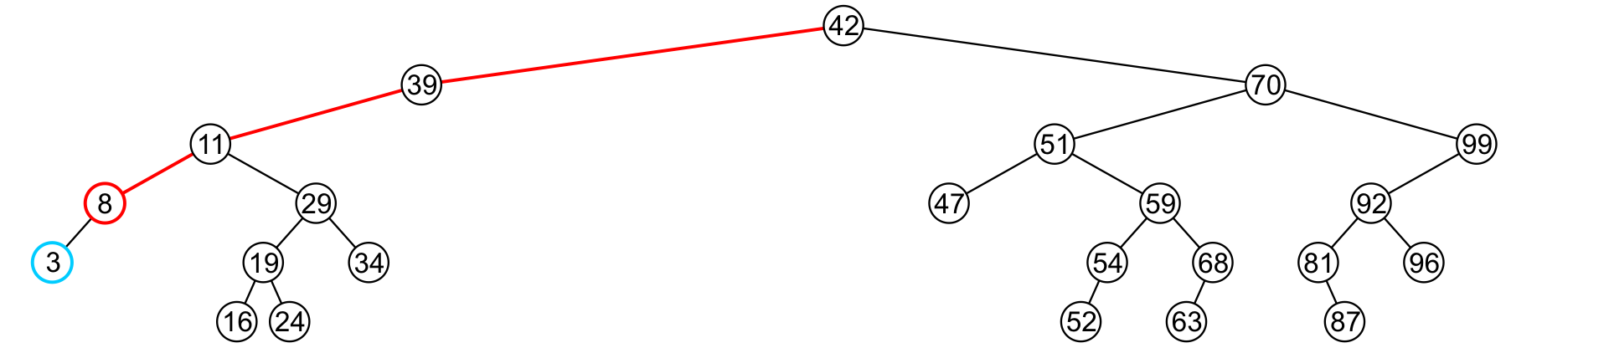
Erase
If a node has only one child, we can simply promote the sub-tree associated with the child
Consider removing 8 which has one left child

Slide 38
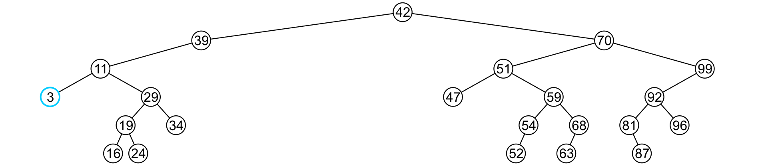
Erase
The node 8 is deleted and the left_tree of 11 is updated to point to 3

Slide 39
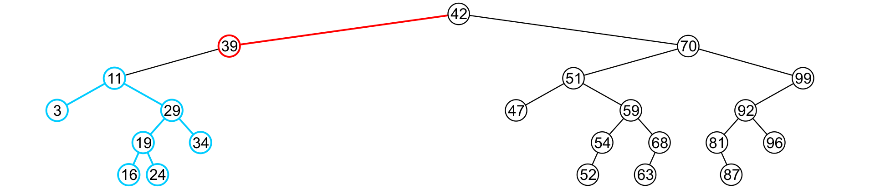
Erase
There is no difference in promoting a single node or a sub-tree
To remove 39, it has a single child 11

Slide 40
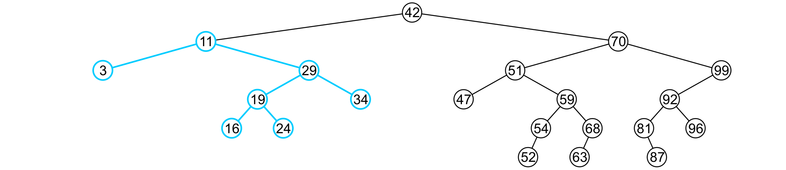
Erase
The node containing 39 is deleted and left_node of 42 is updated to point to 11
Notice that order is still maintained

Slide 41
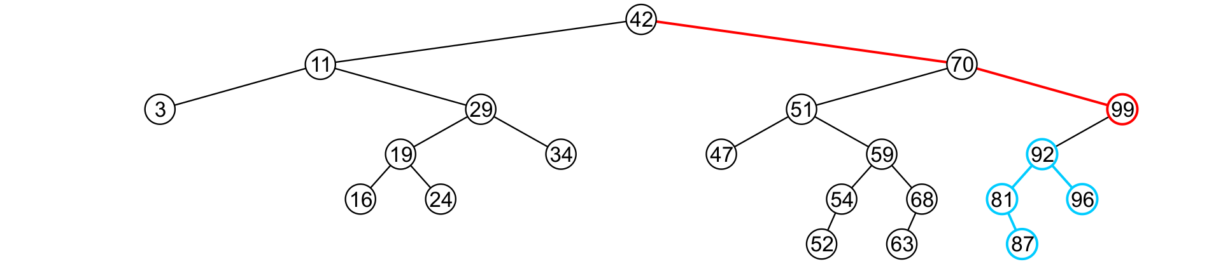
Erase
Consider erasing the node containing 99

Slide 42
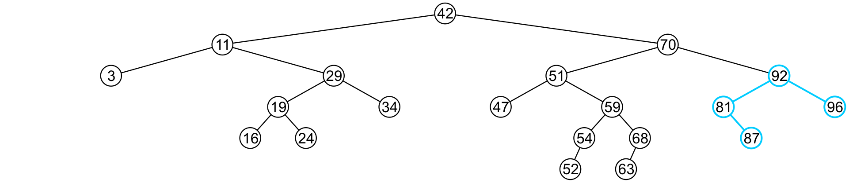
Erase
The node is deleted and the left sub-tree is promoted:
The member variable right_tree of 70 is set to point to 92
Again, the order of the tree is maintained

Slide 43
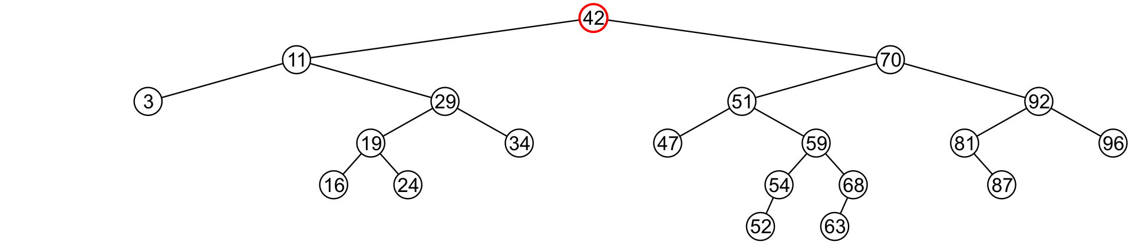
Erase
Finally, we will consider the problem of erasing a full node, e.g., 42
We will perform two operations:
Replace 42 with the minimum object in the right sub-tree
Erase that object from the right sub-tree

Slide 44
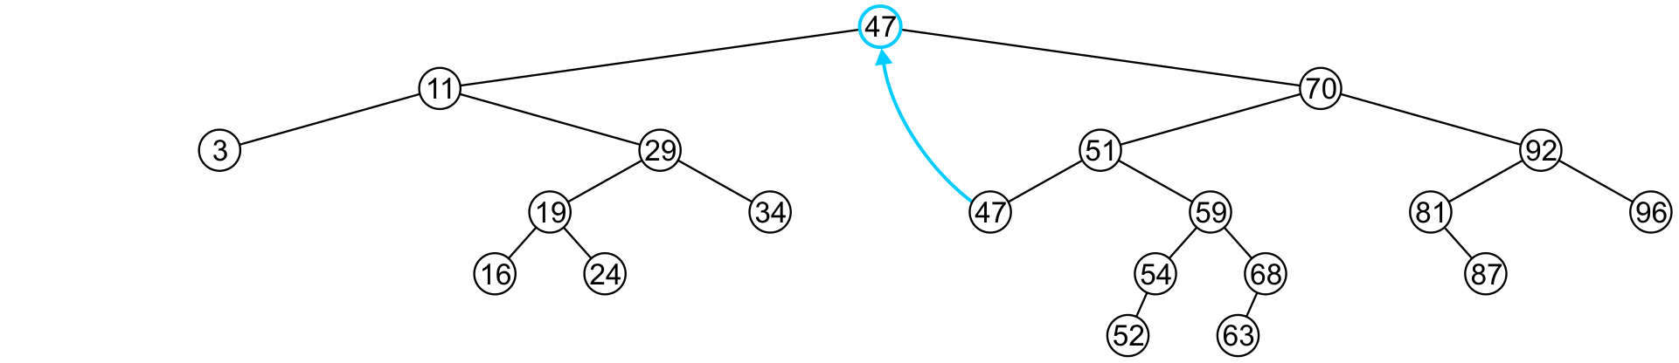
Erase
In this case, we replace 42 with 47
We temporarily have two copies of 47 in the tree

Slide 45
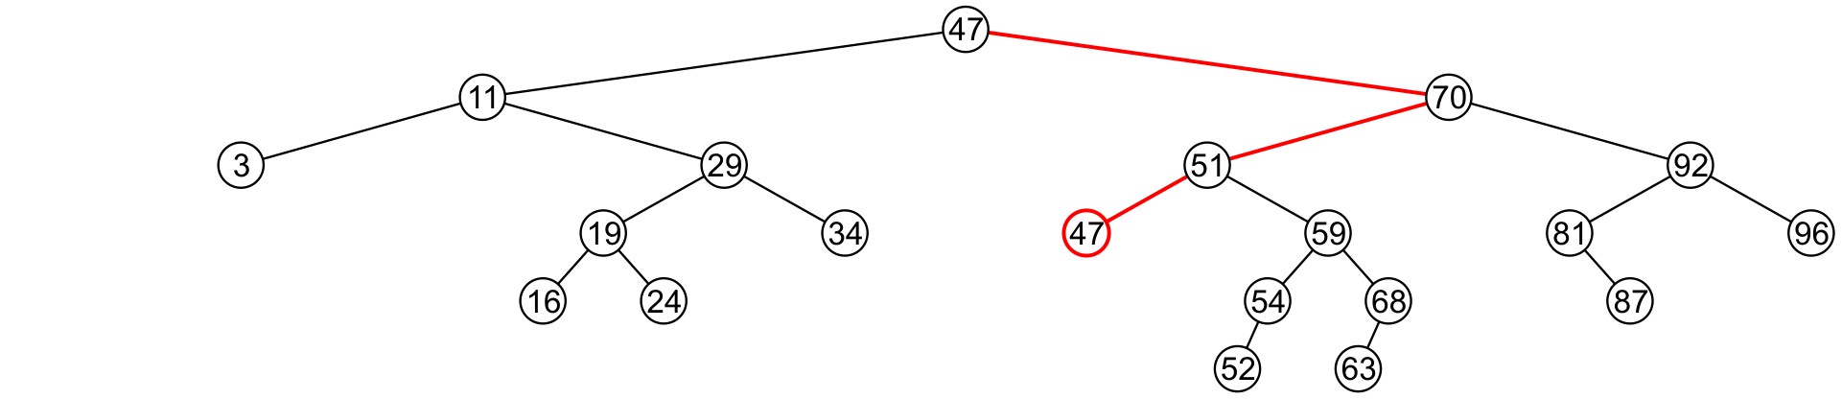
Erase
We now recursively erase 47 from the right sub-tree
We note that 47 is a leaf node in the right sub-tree

Slide 46
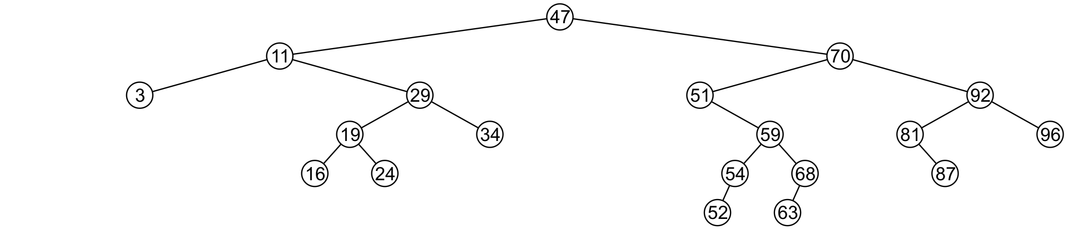
Erase
Leaf nodes are simply removed and left_tree of 51 is set to nullptr
Notice that the tree is still sorted:
47 was the least object in the right sub-tree

Slide 47
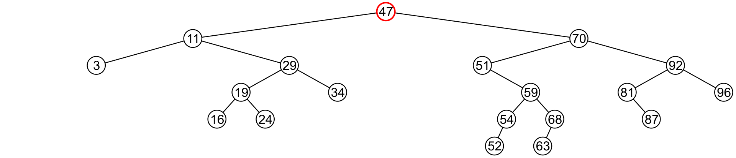
Erase
Suppose we want to erase the root 47 again:
We must copy the minimum of the right sub-tree
We could promote the maximum object in the left sub-tree and achieve similar results

Slide 48
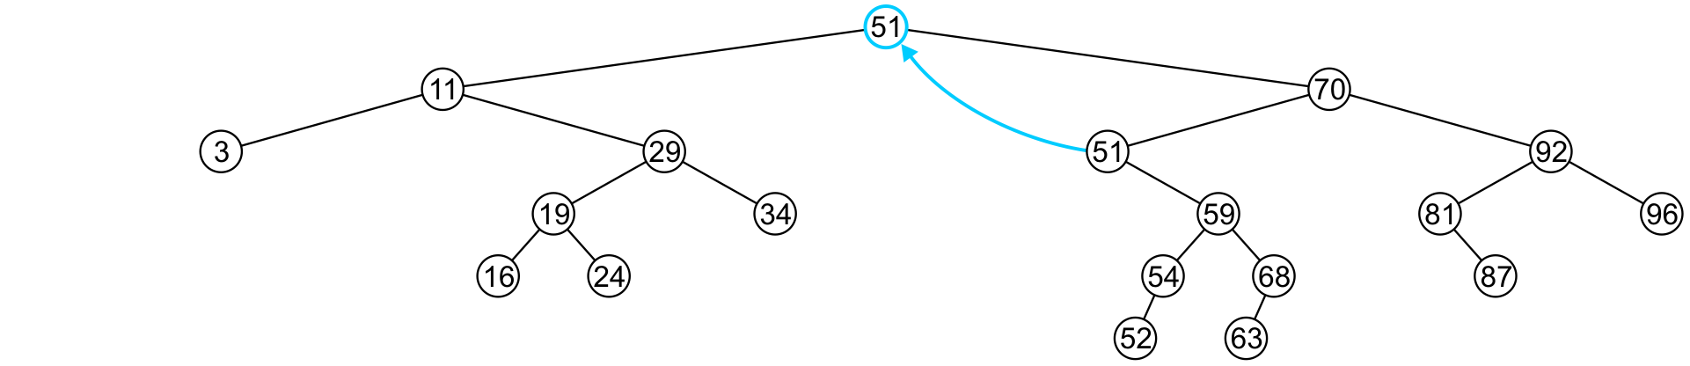
Erase
We copy 51 from the right sub-tree

Slide 49
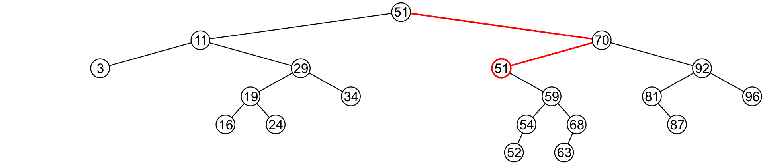
Erase
We must proceed by delete 51 from the right sub-tree

Slide 50
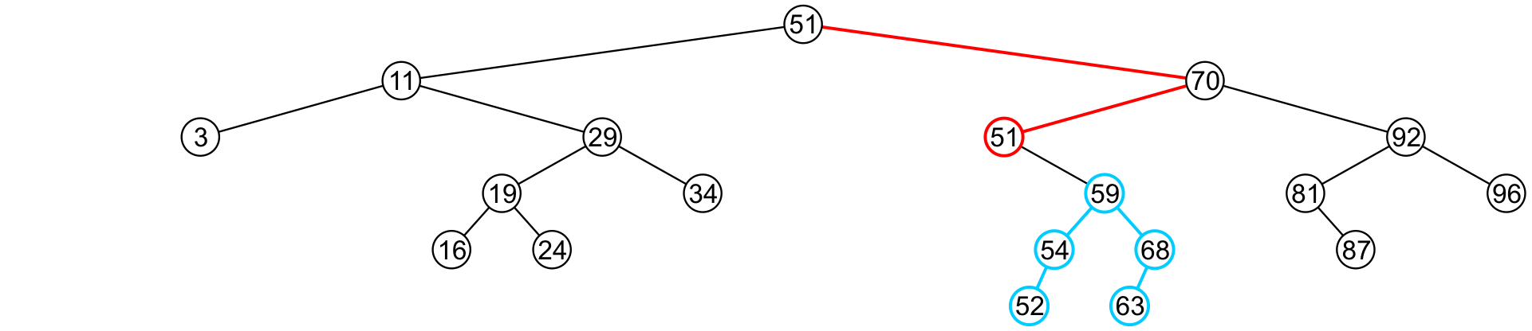
Erase
In this case, the node storing 51 has just a single child

Slide 51
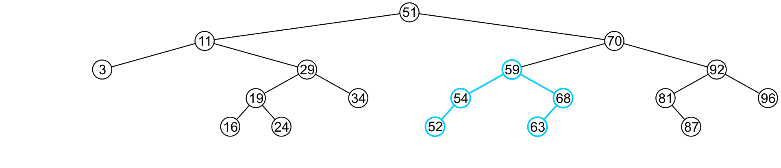
Erase
We delete the node containing 51 and assign the member variable left_tree of 70 to point to 59

Slide 52
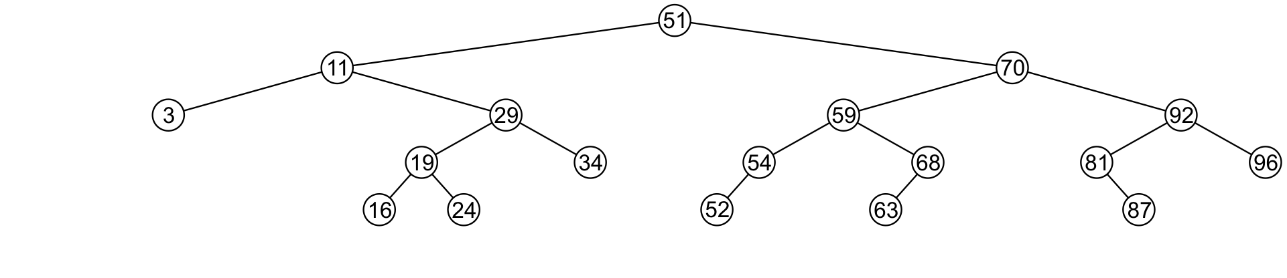
Erase
Note that after seven removals, the remaining tree is still correctly sorted

Slide 53


Erase
In the two examples of removing a full node, we promoted:
A node with no children
A node with right child
Is it possible, in removing a full node, to promote a child with two children?

Slide 54
Erase
Recall that we promoted the minimum element in the right sub-tree
If that node had a left sub-tree, that sub-tree would contain a smaller value

Slide 55
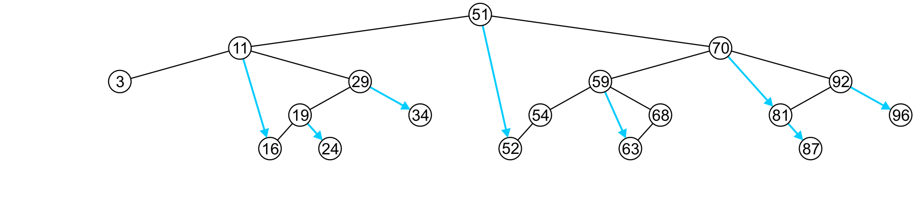
Previous and Next Objects
To find the next largest object:
If the node has a right sub-tree, the minimum object in that sub-tree is the next-largest object

Slide 56
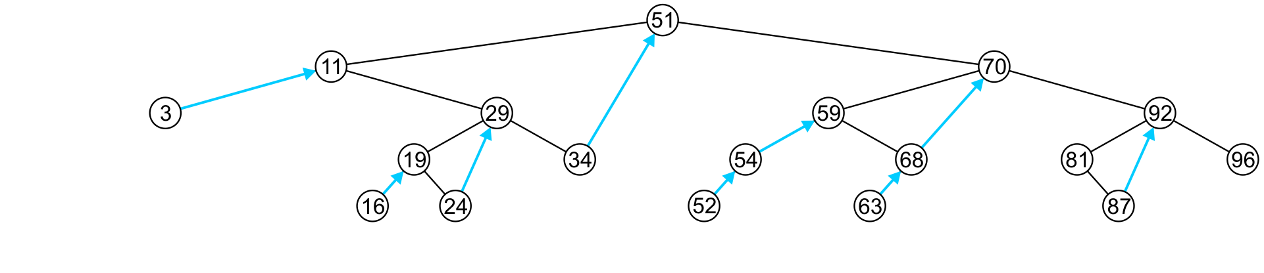
Previous and Next Objects
If, however, there is no right sub-tree:
It is the next largest object (if any) that exists in the path from the root to the node
Go up and right to find this

Slide 57
Finding the k^{th} Object
Another operation on sorted lists may be finding the k^{th} largest object
Recall that k goes from 0 to n – 1
If the left-sub-tree has ℓ = k entries, return the current node,
If the left sub-tree has ℓ > k entries, return the k^{th} entry of the left sub-tree,
Otherwise, the left sub-tree has ℓ < k entries, so return the (k – ℓ – 1)^{th} entry of the right sub-tree

